Slide 1
Balancing Building Performance
Risk And Reward

Slide 2
Presentation Series
What’s next.
Pre-Design | Sept 21
Scope development, contract language (Based on AIA E204-2017 Sustainable Projects Exhibit and setting expectations with the client.
Design | Oct 5
Energy target setting and modeling (Based on ASHRAE Standard 209); defining the scope, and managing execution through a project.
Construction Documents & Administration | October 19
Reviewing specification language (For Division 01- General Requirements), substitutions and RFI procedures, project turnover, commissioning, and post occupancy considerations

Slide 3
Speakers
Anica Landreneau
Director of Sustainability
Donovan Olliff
General Council
Allison Johnson
Sustainable Design Leader

Slide 4
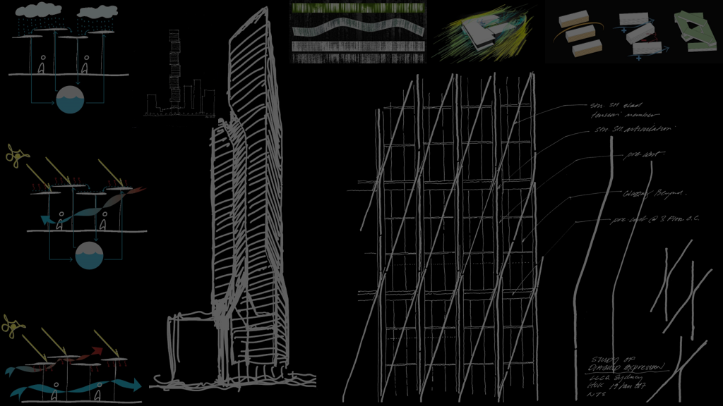
Performance + Accountability
Managing Risk + Optimal Outcomes
Module 2: Design Stage
Consultant Contracts + Design Management

Slide 5
Landmark Green Building Codes + Policies
2017: Benchmarking ordinance was passed requiring all buildings over 50,000 SF to report energy usage through Energy Star Portfolio
2020: St. Louis City passed a building energy performance standard ordinance requiring that all municipal, institutional, commercial and multifamily buildings equal to or greater than 50,000 square feet must consume energy at or below a standard set by the city
2021: Targets were established for building performance standard
2025: BEPS Compliance Cycle 1 ends
2026: BEPS Targets established for Cycle 2

Slide 6
BEPS Compliance Cycles for 50k+ sf
May 2021
May 2025
May 2026
May 2030
May 2031
May 2035
2017
2018
2020
2021
1st BEPS Compliance Cycle BEGINS: 50K+ sf; targets established
2nd BEPS Compliance Cycle targets established
3rd BEPS Compliance Cycle ENDS: 50K+ sf
2nd BEPS Compliance Cycle ENDS
Benchmarking ordinance passed
3rd BEPS Compliance Cycle BEGINS: 50K+ sf
2018 International Energy Conservation Code adopted
1st BEPS Compliance Cycle ENDS
BEPS ordinance passed
BEPS published

Slide 7
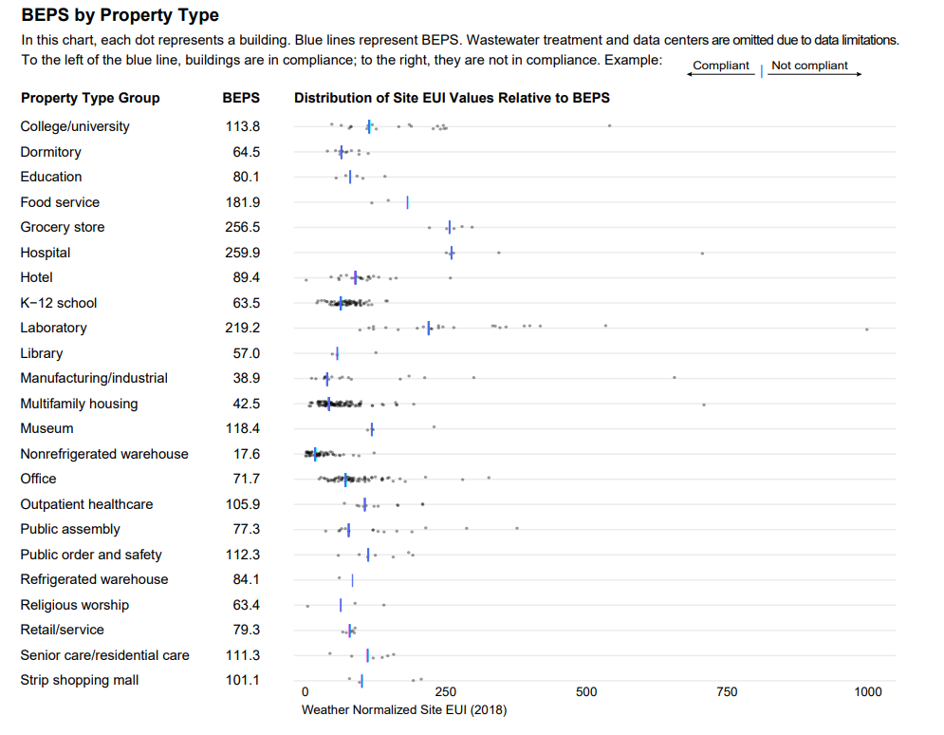
BEPS
By
Property
Type:
Cycle 1
Notes:
BUILDING TYPE
Building types that are historically inefficient (i.e. K-12 or Senior Care or Hotels) may see steeper curve on future BPS

Slide 8
Managing Performance: Energy Modeling
Notes:
Real change in any endeavor is not achievable unless you set targets, measure performance, and track progress toward your goal.
Whether energy performance, diversity or even something as simple as weight loss.
You are what your measure. This is the intent behind BPS.
Given all that is at stake in reducing energy use and carbon footprints, it is important to know how to comply with these requirements in a way that does not create additional liability for the architect.

Slide 9
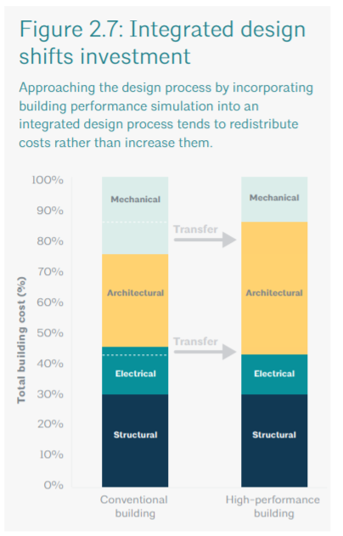
“In 2019 alone, projects that used energy modeling were 32% more energy efficient than non-modeled projects. That means if a company is not modeling, it is leaving real energy and costs savings for its clients on the table.”
“When conducted early and often in the design process, energy modeling helps designers test design solutions to cost-effectively optimize performance beyond energy in order to improve occupant comfort and resilience.”
AIA’s Architect’s Guide to Building Performance: Integrating Performance Simulation in the Design Process is a good resource for designers.
https://content.aia.org/sites/default/files/2021-07/2030-Annual-Report.pdf
https://www.aia.org/resources/6157114-architects-guide-to-building-performance
Notes:
https://content.aia.org/sites/default/files/2021-07/2030-Annual-Report.pdf
https://www.aia.org/resources/6157114-architects-guide-to-building-performance

Slide 10
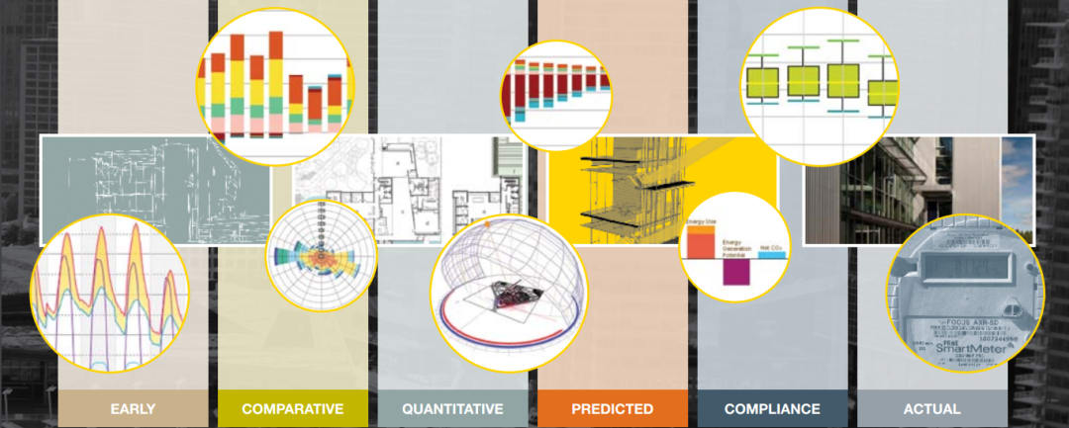
The Architect’s Guide
https://www.aia.org/resources/8056-architects-guide-to-integrating-energy-modeli

Slide 11
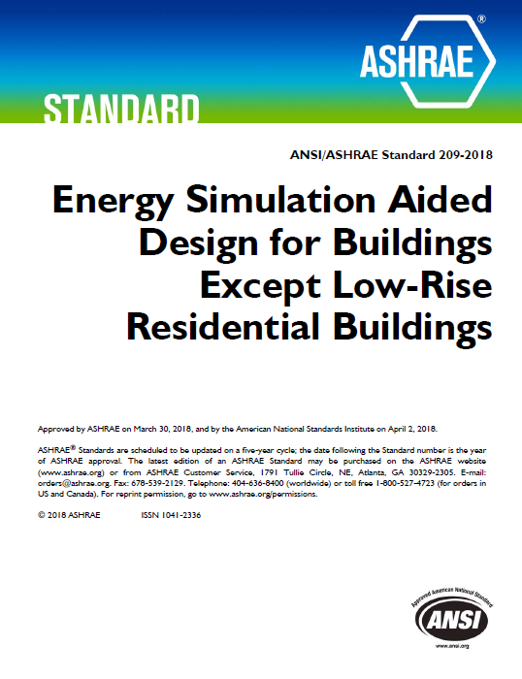
Standardized…
When you need to define energy modeling scope & deliverables:
What kind of models do you want and when?
What kind of feedback?
When do you want workshops?
Who should participate?
Which cycles are included in basic services, and which are excluded as additional services?
Notes:
ENERGY MODELING
Energy Modeling adds cost
ASHRAE 209 is a cafeteria approach – not all energy cycles required
Minimum: Load Reduction Modeling/ Change Order Modeling
Recommended: All design cycles and construction phase cycles including change order analysis

Slide 12
ASHRAE 209: Minimum Requirements
Section 5 General Requirements
Section 6.3 “Modeling Cycle 3 - Load Reduction Modeling”
Section 6: Select at least one (1):
Section 6.1 “Modeling Cycle 1 - Simple Box Modeling
Section 6.2 “Modeling Cycle 2 - Conceptual Design Modeling”
Section 6.4 “Modeling Cycle 4 - HVAC System Selection Modeling”
Section 6.5 “Modeling Cycle 5 - Design Refinement”
Section 6.6 “Modeling Cycle 6 - Design Integration and Optimization”
Section 6.7 “Modeling Cycle 7 - Energy Simulation Aided Value Engineering”

Slide 13
ASHRAE 209: Optional (Module 3)
Section 7 Construction Phase Cycles
Section 7.1 “Modeling Cycle 8 – As-Designed Energy Performance”
Section 7.2 “Modeling Cycle 9 – Change Orders”
Section 7.3 “Modeling Cycle 10 – As-Built Energy Performance”
Section 8 Post-Occupancy Phase Cycles
Section 8.1 “Modeling Cycle 11 – Post-Occupancy Energy Performance Comparison”

Slide 14
ASHRAE 209: Visualized
Concept Design
Schematic Design
Design Development
Construction Documents
Construction Administration
Post Occupancy
5.3 Climate & Site Analysis
5.4 Benchmarking
6.1 Simple box model
6.2 Conceptual design model
6.3 Load reduction model
6.4 HVAC system selection model
6.5 Design refinement models (50%, 100%)
6.5 Design refinement model (50%)
6.6 Design integration & optimization (100%)
6.7 Simulation aided value engineering
6.6 Design integration & optimization (50%, 95%)
6.7 Simulation aided value engineering
7.1 As-designed Energy Performance
ASHRAE 209 energy modeling
7.1 As-designed Energy Performance
7.2 Change Orders
7.3 As-built energy performance
8.1 Post-Occupancy energy performance comparison
5.6 Project targets & goals integrated with Owner’s Project Requirements (OPR)
Design Team: issue Basis of Design (BOD)
CxA: Coordination with model reviews
CxA: Cx Plan, OPR/BOD alignment; Peer review dwg sets, outline spec;
Coordination with model reviews
CxA: Peer review dwg sets, Cx spec, pre-functional checklists;
Coordination with model reviews
10-month site revisit
Monitoring Based Commissioning
*Occupant Comfort Survey
Commissioning activities
Onsite Cx activities;
Coordination with model reviews; O&M manuals, O&M training; Retro-Cx planning
Stakeholder workshops
5.5 Energy Charrette
50% & 100% model review workshops
Cx & model review workshops
Cx & model review workshops
Construction kick-off;
Cx activities and meetings; model review workshops
POE, Lessons Learned & model review workshop

Slide 15
The Shockingly Short Payback of Energy Modeling
Payback on
Project Name
% Modeling
Annual Modeled
Modeling
Fees vs Gross
Energy Cost
Fees in
Fees
Savings
MONTHS
Office Building
0.7%
$122,876
2
Office Building
0.5%
$306,692
1
Justice Center
0.8%
$350,000
3
Convention Hotel
0.6%
$233,791
1
Regional Hospital
2.4%
$3,300,000
1
Government Office Building
3.3%
$186,000
4
Government Building 20
1.1%
$224,276
2
Cancer & Critical Care Tower
0.6%
$853,013
3
Institutional Research Center
0.6%
$340,000
3
Energy Institute, Net Zero
2.5%
$169,432
7
Institutional Research Facility
1.0%
$302,169
1
Science Teaching and Research Facility
0.8%
$419,599
1
Corporate Headquarters
1.0%
$239,835
4
Internal study performed by HOK
https://energy.gov/eere/buildings/articles/shockingly-short-payback-energy-modeling
Notes:
Energy modeling can cost between 1 and 2 % of fees – it is already included in many projects due to project type (like healthcare, labs) or those that are going for LEED New Construction.
The case for investing in energy modeling is very strong – in all cases, the payback for energy modeling is less than a year – in most cases it is 3 months or less.
Plus in many parts of the US, energy modeling for design projects is subsidized by utilities.

Slide 16
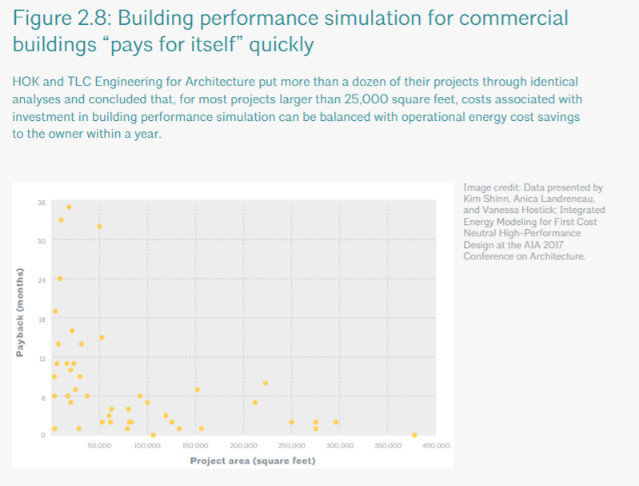
https://content.aia.org/sites/default/files/2021-07/2030-Annual-Report.pdf
https://www.aia.org/resources/6157114-architects-guide-to-building-performance

Slide 17
ASHRAE 209: Minimum Requirements
Section 5 General Requirements
5.1 Simulation Software Requirements: consistent with ASHRAE 90.1, Section G2.2 and the IECC 2018.
5.2 Energy Modeler Credentials: certified Building Energy Modeling Professional (BEMP) or Building Energy Simulation Analyst (BESA), or equivalent credential approved by St. Louis Bldg Div/Office of Bldg Performance.
5.3 Climate and Site Analysis: parameters for simulation
5.4 Benchmarking: compare to peer buildings to set target metrics
5.5 Energy Charrette: goal setting & strategies workshop
5.6 Energy Performance Goals in Owner’s Project Requirements (OPR): setting the stage for BEPS compliance
5.7 General Modeling Cycle Requirements baseline and goals, inputs, outputs, QA/QC, reviews

Slide 18
ASHRAE 209: Visualized
LEED Integrative Process
aligns with General Requirements + Cycle 1
Concept Design
Schematic Design
Design Development
Construction Documents
Construction Administration
Post Occupancy
5.3 Climate & Site Analysis
5.4 Benchmarking
6.1 Simple box model
6.2 Conceptual design model
6.3 Load reduction model
6.4 HVAC system selection model
6.5 Design refinement models (50%, 100%)
6.5 Design refinement model (50%)
6.6 Design integration & optimization (100%)
6.7 Simulation aided value engineering
6.6 Design integration & optimization (50%, 95%)
6.7 Simulation aided value engineering
7.1 As-designed Energy Performance
ASHRAE 209 energy modeling
7.1 As-designed Energy Performance
7.2 Change Orders
7.3 As-built energy performance
8.1 Post-Occupancy energy performance comparison
5.6 Project targets & goals integrated with Owner’s Project Requirements (OPR)
Design Team: issue Basis of Design (BOD)
CxA: Coordination with model reviews
CxA: Cx Plan, OPR/BOD alignment; Peer review dwg sets, outline spec;
Coordination with model reviews
CxA: Peer review dwg sets, Cx spec, pre-functional checklists;
Coordination with model reviews
10-month site revisit
Monitoring Based Commissioning
*Occupant Comfort Survey
Commissioning activities
Onsite Cx activities;
Coordination with model reviews; O&M manuals, O&M training; Retro-Cx planning
Stakeholder workshops
5.5 Energy Charrette
50% & 100% model review workshops
Cx & model review workshops
Cx & model review workshops
Construction kick-off;
Cx activities and meetings; model review workshops
POE, Lessons Learned & model review workshop

Slide 19
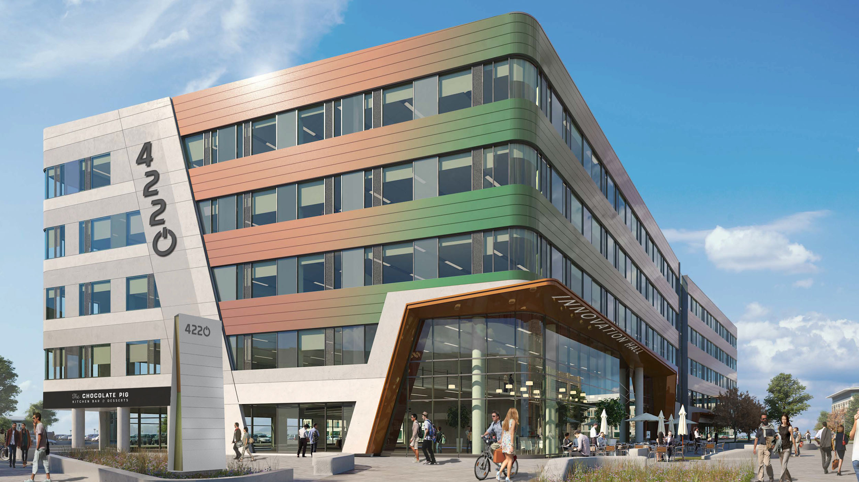
4220
EUI (2021):
59.1 kbtu/sf/yr
BEPS:
71.7 kbtu/sf/yr
Notes:
BUILDING TYPE
Building types that are historically inefficient (i.e. K-12 or Senior Care or Hotels) may see steeper curve on future BPS

Slide 20
Grand Flats
EUI (2021):
22.8 kbtu/sf/yr
If meets EUI target and exceeds 2018 Property Baseline by 50%, then exempt for cycles 1, 2 and 3.
BEPS EUI:
42.5 kbtu/sf/yr
Notes:
BUILDING TYPE
Building types that are historically inefficient (i.e. K-12 or Senior Care or Hotels) may see steeper curve on future BPS

Slide 21
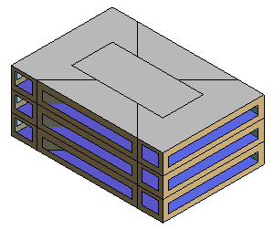
ASHRAE 209: Select (at least) One Cycle:
Section 6.1 “Modeling Cycle 1 - Simple Box Modeling”
This cycle is a sensitivity analysis; it is strongly recommended as a Basic Service due to its alignment with the IECC 2018, in addition to support of BEPS compliance.
This modeling cycle aligns with the LEED credit for Integrative Process
This cycle is typically performed in Concept or early SD.
Notes:
ENCOURAGED: This cycle is strongly recommended as a Basic Service due to its alignment with the DC Energy Code and DC Green Building Act, in addition to support of BEPS compliance.
This is an orientation-neutral model, often conducted before building geometry is set. It is also known as shoebox model. It allows the team to apply early ideas to the project to keep on the table or reject based on high level impacts. Sometimes this is used for an early look at systems options, to validate certain design ideas, or to benchmark against a performance goal or target. The box model identifies which design characteristics will have the most impact on building performance, such as orientation, massing, window to wall ratio (WWR), high performance thermal envelope, daylighting, or HVAC system efficiency. For example, in a climate with predominantly overcast skies it might become evident that building orientation has very little impact on performance. On an office building or academic building where loads are externally driven, a high-performance envelope might have a meaningful impact, but there may be a point of diminishing returns. For a more complex building like a laboratory, hospital or data center where loads are internally driven, it might be determined that building form and enclosure are less impactful, but energy recovery ventilation, low friction ducts, or cascading air may lead to a significant reduction in energy use.
This modeling cycle aligns with the LEED credit for Integrative Process, which requires a “simple box” energy model to explore how to reduce energy loads, analyzing any two (2) of the following: a) Site conditions, b) Massing and orientation, c) Building envelope, d) Lighting levels, e) Thermal comfort ranges, f) Plug and process loads, g) Program and operational parameters” thus supporting projects that fall under the DC Green Building Act.
NB: This model is typically self-referencing, rather than a comparison to a baseline. It is an exercise in optimizing the design for its own sake.
WHEN: This cycle is typically performed in Concept or early Schematic Design, but for LEED Integrative Process compliance must be conducted no later than the end of Schematic Design. ASHRAE 209 requires that it is conducted before or during the Energy Charrette, which should be held in Concept or early Schematic design as well.

Slide 22
ASHRAE 209: Visualized
When there are still opportunities to optimize building form
Concept Design
Schematic Design
Design Development
Construction Documents
Construction Administration
Post Occupancy
5.3 Climate & Site Analysis
5.4 Benchmarking
6.1 Simple box model
6.2 Conceptual design model
6.3 Load reduction model
6.4 HVAC system selection model
6.5 Design refinement models (50%, 100%)
6.5 Design refinement model (50%)
6.6 Design integration & optimization (100%)
6.7 Simulation aided value engineering
6.6 Design integration & optimization (50%, 95%)
6.7 Simulation aided value engineering
7.1 As-designed Energy Performance
ASHRAE 209 energy modeling
7.1 As-designed Energy Performance
7.2 Change Orders
7.3 As-built energy performance
8.1 Post-Occupancy energy performance comparison
5.6 Project targets & goals integrated with Owner’s Project Requirements (OPR)
Design Team: issue Basis of Design (BOD)
CxA: Coordination with model reviews
CxA: Cx Plan, OPR/BOD alignment; Peer review dwg sets, outline spec;
Coordination with model reviews
CxA: Peer review dwg sets, Cx spec, pre-functional checklists;
Coordination with model reviews
10-month site revisit
Monitoring Based Commissioning
*Occupant Comfort Survey
Commissioning activities
Onsite Cx activities;
Coordination with model reviews; O&M manuals, O&M training; Retro-Cx planning
Stakeholder workshops
5.5 Energy Charrette
50% & 100% model review workshops
Cx & model review workshops
Cx & model review workshops
Construction kick-off;
Cx activities and meetings; model review workshops
POE, Lessons Learned & model review workshop

Slide 23
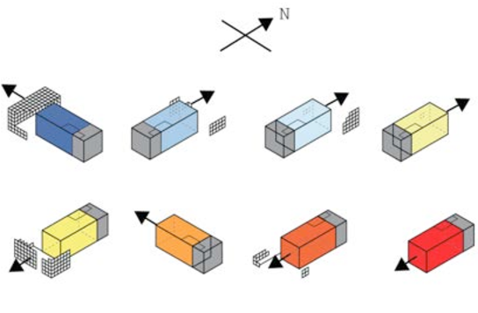
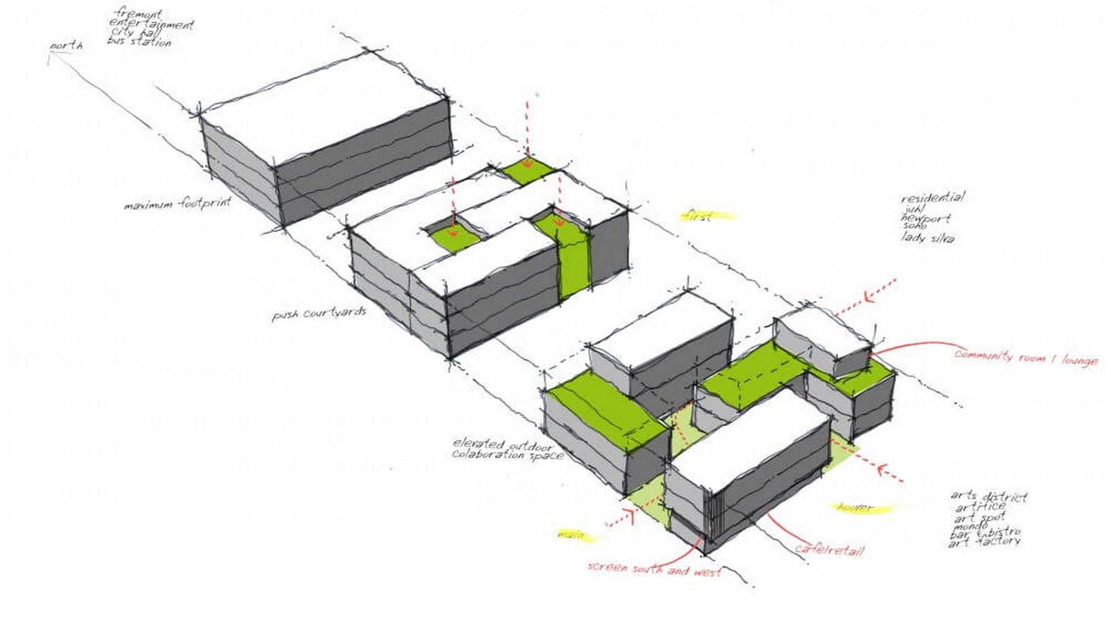
ASHRAE 209: Select (at least) One Cycle:
Section 6.2 “Modeling Cycle 2 - Conceptual Design Modeling”
This cycle may be performed by Architect, Engineer or Consultant, unless the building form and orientation are already determined by site or zoning.
This cycle includes analysis and refinement of the architectural form (orientation, massing, passive design strategies)
This cycle is conducted in Concept Design.
Notes:
ENCOURAGED: This cycle of modeling is relevant if the form of the building is still subject to change before the onset of Schematic Design. This cycle is strongly recommended as a Basic Service, unless the building form and orientation are already determined.
This cycle includes analysis and refinement of the architectural form to fine-tune building performance before systems design begins. This cycle may involve rapid iteration of analysis of building form, orientation, natural or mixed mode ventilation, passive solar heating, daylighting and other passive design strategies. This cycle is often conducted in Sketchup, Rhino or Revit using analysis tools that are supported in each design software platform.
NB: This model is typically self-referencing, rather than a comparison to a baseline. It is an exercise in optimizing the design for its own sake.
WHEN: This cycle must be conducted in Concept Design.

Slide 24
ASHRAE 209: Visualized
Opportunity to right-size HVAC and save construction $$
Concept Design
Schematic Design
Design Development
Construction Documents
Construction Administration
Post Occupancy
5.3 Climate & Site Analysis
5.4 Benchmarking
6.1 Simple box model
6.2 Conceptual design model
6.3 Load reduction model
6.4 HVAC system selection model
6.5 Design refinement models (50%, 100%)
6.5 Design refinement model (50%)
6.6 Design integration & optimization (100%)
6.7 Simulation aided value engineering
6.6 Design integration & optimization (50%, 95%)
6.7 Simulation aided value engineering
7.1 As-designed Energy Performance
ASHRAE 209 energy modeling
7.1 As-designed Energy Performance
7.2 Change Orders
7.3 As-built energy performance
8.1 Post-Occupancy energy performance comparison
5.6 Project targets & goals integrated with Owner’s Project Requirements (OPR)
Design Team: issue Basis of Design (BOD)
CxA: Coordination with model reviews
CxA: Cx Plan, OPR/BOD alignment; Peer review dwg sets, outline spec;
Coordination with model reviews
CxA: Peer review dwg sets, Cx spec, pre-functional checklists;
Coordination with model reviews
10-month site revisit
Monitoring Based Commissioning
*Occupant Comfort Survey
Commissioning activities
Onsite Cx activities;
Coordination with model reviews; O&M manuals, O&M training; Retro-Cx planning
Stakeholder workshops
5.5 Energy Charrette
50% & 100% model review workshops
Cx & model review workshops
Cx & model review workshops
Construction kick-off;
Cx activities and meetings; model review workshops
POE, Lessons Learned & model review workshop

Slide 25
ASHRAE 209: Minimum Requirements
Section 6.3 “Modeling Cycle 3 - Load Reduction Modeling”
This cycle is mandatory in the ASHRAE 209 standard and therefore should be a Basic Service.
This cycle is focused on reducing both annual energy use as well as peak heating and cooling loads.
The former reduces operating expenses and is generally includes in ‘payback’ or Return on Investment (ROI) calculations. Peak loads, on the other hand, are used to determine system sizing and construction costs.
This model must be performed before HVAC system selection and no later than the end of SD.
Notes:
Section 6.3 “Modeling Cycle 3 - Load Reduction Modeling”
REQUIRED: This cycle is mandatory in the ASHRAE 209 standard and therefore should be a Basic Service.
This cycle is focused on reducing both annual energy use as well as peak heating and cooling loads. The former reduces operating expenses and is generally includes in ‘payback’ or Return on Investment (ROI) calculations. For example, if the Owner spends more money on more efficient HVAC equipment, but it saves energy every year, that increased first cost will be paid for through annual energy savings. Peak loads, on the other hand, are used to determine system sizing. Peak load reduction strategies may include but are not limited to: a) building envelope, b) lighting and daylighting, c) internal equipment loads, d) outside air, e) passive conditioning and natural ventilation.
For example, if the team designs a better thermal envelope, specifies better glazing, reduces the Window to Wall Ratio (WWR) or uses exterior sun shades to control solar heat gain, the overall net effect may be lower peak heating and cooling loads, thereby reducing the tons of cooling or Btus of heating necessary for maintaining building comfort. The construction budget may be able to carry fewer or smaller chillers, or be able to reduce or eliminate perimeter heat systems, for example. These are called ‘trade-offs’ and the net effect may be cost neutral in terms of first costs (construction costs) or even a cost savings. These trade-offs are identified and validated through energy modeling and load calculations.
Peak load reduction may impact HVAC system selection or design; understanding how tradeoffs balance the costs of high-performance design elements helps to retain those elements in the design instead of rejecting them out of a gut VE instinct.
NB: This model is self-referencing, rather than a comparison to a baseline. It is an exercise in optimizing the design for its own sake.
WHEN: Because of the potential impacts on the design, this modeling cycle must be performed before HVAC system selection and no later than the end of Schematic Design.

Slide 26
ASHRAE 209: Minimum Requirements
Section 6.3 “Modeling Cycle 3 - Load Reduction Modeling”
Overhangs optimized to reduce insolation on building façade, minimizing glare and solar heat gain in building interior, thus reducing peak cooling loads.

Slide 27
ASHRAE 209: Minimum Requirements
Section 6.3 “Modeling Cycle 3 - Load Reduction Modeling”
Removal or adjustment of overhangs would require reduction of WWR to 50% AND improvement in R-values, U-values of walls, roof, and window systems to conform with code requirements

Slide 28
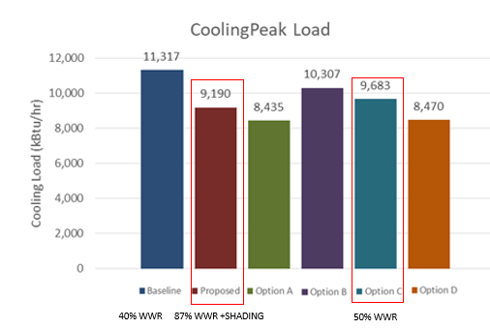
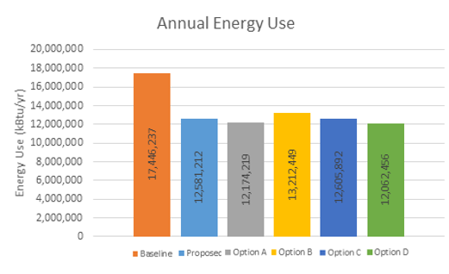
ASHRAE 209: Minimum Requirements
Section 6.3 “Modeling Cycle 3 - Load Reduction Modeling”
Option A – Proposed + better wall, roof, and floor insulation (especially at the slab overhangs)
Option B – Proposed w/o extended slabs for shading
Chillers +13% (+$$)
Mechanical Rooms, CEP size increase (+$$)
Maintenance increase (+$$)
+5% Annual Energy Cost
Option C – Option B with 50% reduced WWR
Option D – Option C + better wall, roof, and floor insulation (+$$)
Baseline – ASHRAE 90.1-2013 Building (FL code)
Proposed – 87% WWR + extended slab edges
24-26% below ASHRAE 90.1-2013 (FL code)
29-31% below ASHRAE 90.1-2010 (LEED v4 baseline) ($ Cost)

Slide 29
ASHRAE 209: Visualized
Informed by load profiles; run after load reduction exercises
Concept Design
Schematic Design
Design Development
Construction Documents
Construction Administration
Post Occupancy
5.3 Climate & Site Analysis
5.4 Benchmarking
6.1 Simple box model
6.2 Conceptual design model
6.3 Load reduction model
6.4 HVAC system selection model
6.5 Design refinement models (50%, 100%)
6.5 Design refinement model (50%)
6.6 Design integration & optimization (100%)
6.7 Simulation aided value engineering
6.6 Design integration & optimization (50%, 95%)
6.7 Simulation aided value engineering
7.1 As-designed Energy Performance
ASHRAE 209 energy modeling
7.1 As-designed Energy Performance
7.2 Change Orders
7.3 As-built energy performance
8.1 Post-Occupancy energy performance comparison
5.6 Project targets & goals integrated with Owner’s Project Requirements (OPR)
Design Team: issue Basis of Design (BOD)
CxA: Coordination with model reviews
CxA: Cx Plan, OPR/BOD alignment; Peer review dwg sets, outline spec;
Coordination with model reviews
CxA: Peer review dwg sets, Cx spec, pre-functional checklists;
Coordination with model reviews
10-month site revisit
Monitoring Based Commissioning
*Occupant Comfort Survey
Commissioning activities
Onsite Cx activities;
Coordination with model reviews; O&M manuals, O&M training; Retro-Cx planning
Stakeholder workshops
5.5 Energy Charrette
50% & 100% model review workshops
Cx & model review workshops
Cx & model review workshops
Construction kick-off;
Cx activities and meetings; model review workshops
POE, Lessons Learned & model review workshop

Slide 30
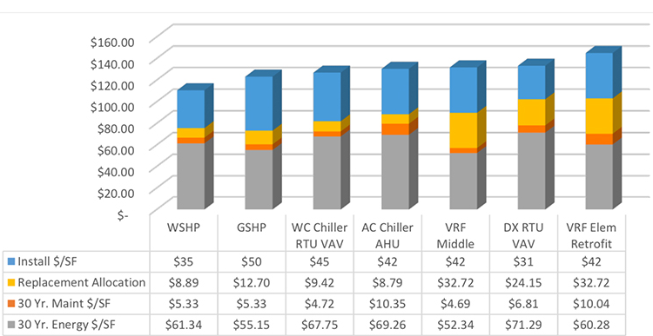
ASHRAE 209: Select (at least) One Cycle:
Section 6.4 “Modeling Cycle 4 - HVAC System Selection Modeling”
This cycle can be used to compare lifecycle costs of various system options.
Engage building operations personnel to discuss experience with existing systems, occupant comfort, O&M protocols, any concerns about new systems.
This cycle must be conducted after Cycle 3 – Load Reduction Modeling & before the HVAC system is selected. This typically occurs in late SD or early DD.
Notes:
IF APPLICABLE: This cycle of modeling is useful if more than one HVAC system is under consideration, for example radiant systems vs. forced air systems. This cycle is recommended as an Additional Service unless it is known to be relevant and critical to the design process from the outset.
This cycle can be used to evaluate the annual energy demand impacts of various system options and the resulting impacts on building operating expenses. Modeling system options supports Life Cycle Cost Analysis (LCCA), which includes first costs, operating costs, maintenance costs, replacement costs, decommissioning costs and anticipated annual energy savings. This is often a good time to engage building operations personnel to discuss experience with existing systems, problems and challenges with occupant comfort, Operations and Maintenance protocols, as well as any concerns about new proposed systems. Education or training for new systems can begin at this stage if modeling shows compelling reason to pursue certain types of systems.
NB: This modeling cycle begins to compare the design case to a baseline standard. There may be variations in the energy standards cited for code and certifications like LEED, so there may be one or more variations to the baseline model.
WHEN: This cycle must be conducted after Cycle 3 – Load Reduction Modeling and before the HVAC system is selected. This typically occurs in late Schematic Design or early Design Development, no late than 50% Design Development.

Slide 31
ASHRAE 209: Visualized
May overlap SD & DD; define timing and number of iterations in contract scope language
Concept Design
Schematic Design
Design Development
Construction Documents
Construction Administration
Post Occupancy
5.3 Climate & Site Analysis
5.4 Benchmarking
6.1 Simple box model
6.2 Conceptual design model
6.3 Load reduction model
6.4 HVAC system selection model
6.5 Design refinement models (50%, 100%)
6.5 Design refinement model (50%)
6.6 Design integration & optimization (100%)
6.7 Simulation aided value engineering
6.6 Design integration & optimization (50%, 95%)
6.7 Simulation aided value engineering
7.1 As-designed Energy Performance
ASHRAE 209 energy modeling
7.1 As-designed Energy Performance
7.2 Change Orders
7.3 As-built energy performance
8.1 Post-Occupancy energy performance comparison
5.6 Project targets & goals integrated with Owner’s Project Requirements (OPR)
Design Team: issue Basis of Design (BOD)
CxA: Coordination with model reviews
CxA: Cx Plan, OPR/BOD alignment; Peer review dwg sets, outline spec;
Coordination with model reviews
CxA: Peer review dwg sets, Cx spec, pre-functional checklists;
Coordination with model reviews
10-month site revisit
Monitoring Based Commissioning
*Occupant Comfort Survey
Commissioning activities
Onsite Cx activities;
Coordination with model reviews; O&M manuals, O&M training; Retro-Cx planning
Stakeholder workshops
5.5 Energy Charrette
50% & 100% model review workshops
Cx & model review workshops
Cx & model review workshops
Construction kick-off;
Cx activities and meetings; model review workshops
POE, Lessons Learned & model review workshop

Slide 32
ASHRAE 209: Select (at least) One Cycle:
Section 6.5 “Modeling Cycle 5 - Design Refinement”
This cycle is strongly recommended as a Basic Service.
As building design becomes more detailed, program and space layout confirmed, lighting, occupants, plugloads, HVAC systems, etc. model can become more accurate.
Coordinate with Cx and BECx activities.
Consider iterations at 50% & 100% SD, 50% & 100% DD.
DC Consolidated Forensic Lab
Notes:
ENCOURAGED: This cycle is strongly recommended as a Basic Service.
As the building design becomes more detailed, space use and partitioning are more defined, preliminary lighting layout is developed, AV and plug loads are provided, and other inputs are generated, the model can be updated and become more accurate. The model can be used as a tool to validate the direction of the design or highlight areas that are off course and need more attention. This cycle should be iterative, and the number of iterations depends on the size and complexity of the project as well as the design schedule. At a minimum, modeling should include updates on a) HVAC systems, b) Lighting Systems, c) Envelope Systems, d) Service Water Heating Systems, e) Process and Plug-load systems. After each iteration, a model review meeting or discussion would be helpful to discuss EEM and design opportunities. These meetings should be coordinated with commissioning activities once commissioning commences.
NB: There may be variations in the energy standards cited for code and certifications like LEED, so while the ‘design case’ may consistently reference the same standard, there may be one or more variations to the baseline model.
WHEN: This cycle should be iterative and may include check-ins at 50% and 100% Schematic Design, and 50% Design Development, to be defined in the Architect-Consultant scope agreement.

Slide 33
ASHRAE 209: Select (at least) One Cycle:
Section 6.5 “Modeling Cycle 5 - Design Refinement”
Labs (North)
Offices
(South)
Entry/Circulation
DC Consolidated Forensic Lab: organization of program, occupants, enclosure design, mechanical design confirmed and more detailed.

Slide 34
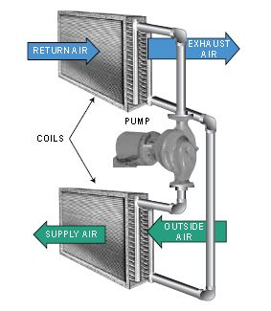
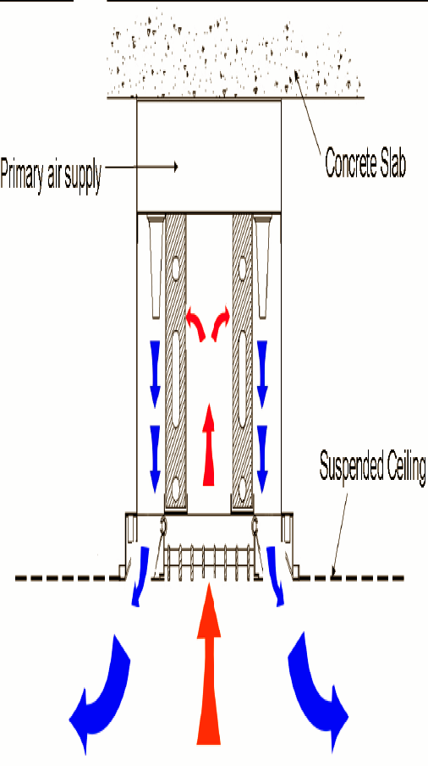
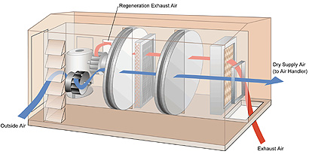
ASHRAE 209: Select (at least) One Cycle:
Section 6.5 “Modeling Cycle 5 - Design Refinement”
DC Consolidated Forensic Lab: organization of program, occupants, enclosure design, mechanical design confirmed and more detailed.

Slide 35
ASHRAE 209: Visualized
May overlap DD & CDs; define timing and number of iterations in contract scope language
Concept Design
Schematic Design
Design Development
Construction Documents
Construction Administration
Post Occupancy
5.3 Climate & Site Analysis
5.4 Benchmarking
6.1 Simple box model
6.2 Conceptual design model
6.3 Load reduction model
6.4 HVAC system selection model
6.5 Design refinement models (50%, 100%)
6.5 Design refinement model (50%)
6.6 Design integration & optimization (100%)
6.7 Simulation aided value engineering
6.6 Design integration & optimization (50%, 95%)
6.7 Simulation aided value engineering
7.1 As-designed Energy Performance
ASHRAE 209 energy modeling
7.1 As-designed Energy Performance
7.2 Change Orders
7.3 As-built energy performance
8.1 Post-Occupancy energy performance comparison
5.6 Project targets & goals integrated with Owner’s Project Requirements (OPR)
Design Team: issue Basis of Design (BOD)
CxA: Coordination with model reviews
CxA: Cx Plan, OPR/BOD alignment; Peer review dwg sets, outline spec;
Coordination with model reviews
CxA: Peer review dwg sets, Cx spec, pre-functional checklists;
Coordination with model reviews
10-month site revisit
Monitoring Based Commissioning
*Occupant Comfort Survey
Commissioning activities
Onsite Cx activities;
Coordination with model reviews; O&M manuals, O&M training; Retro-Cx planning
Stakeholder workshops
5.5 Energy Charrette
50% & 100% model review workshops
Cx & model review workshops
Cx & model review workshops
Construction kick-off;
Cx activities and meetings; model review workshops
POE, Lessons Learned & model review workshop

Slide 36
ASHRAE 209: Select (at least) One Cycle:
Section 6.6 “Modeling Cycle 6 - Design Integration and Optimization”
This cycle is strongly recommended as a Basic Service.
As the building design becomes more detailed: enclosure materials, glazing systems, MEP sub-systems, sensors, controls, scheduling, etc. are specified, the model can get more detailed & accurate.
Coordinate with Cx and BECx activities.
This cycle should be iterative and may include check-ins at 50% & 95% CDs.
Oregon State Hospital in Junction City
Notes:
ENCOURAGED: This cycle is strongly recommended as a Basic Service.
As the building design becomes more detailed, as enclosure materials and glazing systems are selected, systems and sub-systems more detailed and complex, HVAC system components, sensors and controls, scheduling, etc. are determined, the model can get more detailed and more accurate. If a couple of options are under consideration, the model can be used to evaluate merits (energy savings) of those options. the model can be updated and iterated for multi-variable optimization. This allows the team to identify when two or more design elements have a compounding impact on energy performance. This cycle should be iterative, and the number of iterations depends on the size and complexity of the project as well as the design schedule. After each iteration, a model review meeting or discussion would be helpful to discuss EEM and design opportunities. These meetings should be coordinated with commissioning activities.
NB: There may be variations in the energy standards cited for code and certifications like LEED, so while the ‘design case’ may consistently reference the same standard, there may be one or more variations to the baseline model.
WHEN: This cycle should be iterative and may include check-ins at 50% and 100% Design Development, 50% and 95% Construction Documents, to be defined in the Architect-Consultant scope agreement.

Slide 37
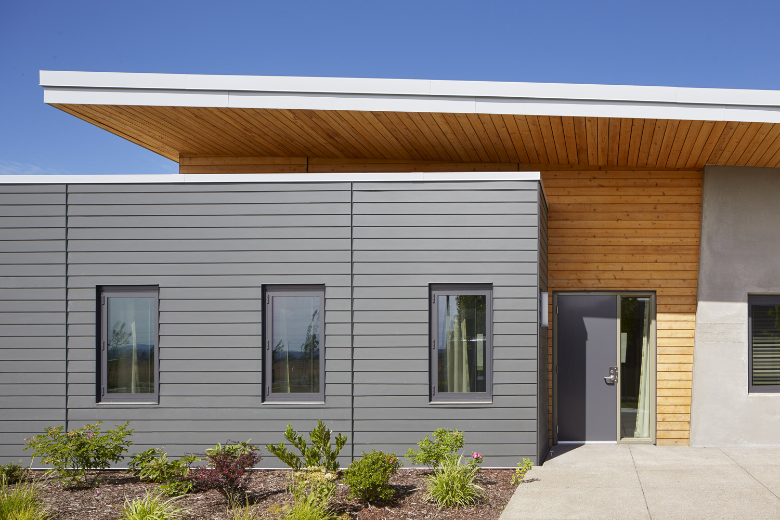
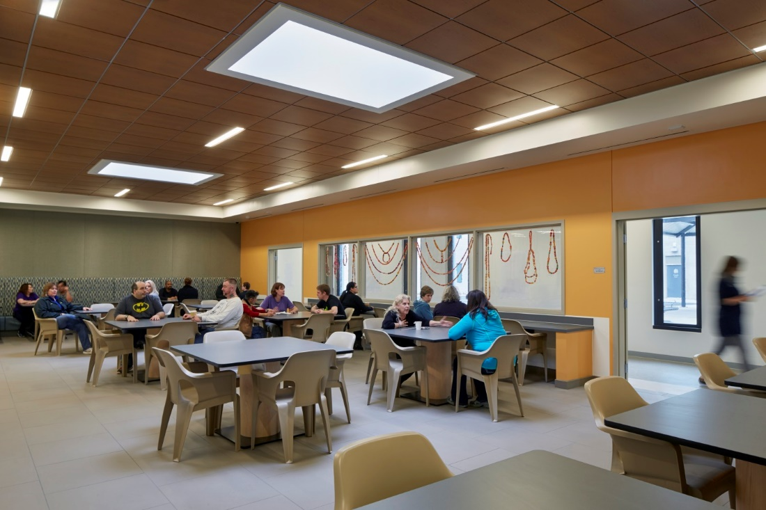
ASHRAE 209: Select (at least) One Cycle:
Section 6.6 “Modeling Cycle 6 - Design Integration and Optimization”
Oregon State Hospital in Junction City: tight envelope with limited WWR optimized daylighting while reducing heating & cooling loads. Night flushing was employed in select spaces (e.g. gymnasium). Chilled beams reduced F2F height. Energy recovery & demand-controlled ventilation reduced loads. Geoexchange, solar thermal H2O support 100% heating & cooling needs.
Notes:
ENCOURAGED: This cycle is strongly recommended as a Basic Service.
As the building design becomes more detailed, as enclosure materials and glazing systems are selected, systems and sub-systems more detailed and complex, HVAC system components, sensors and controls, scheduling, etc. are determined, the model can get more detailed and more accurate. If a couple of options are under consideration, the model can be used to evaluate merits (energy savings) of those options. the model can be updated and iterated for multi-variable optimization. This allows the team to identify when two or more design elements have a compounding impact on energy performance. This cycle should be iterative, and the number of iterations depends on the size and complexity of the project as well as the design schedule. After each iteration, a model review meeting or discussion would be helpful to discuss EEM and design opportunities. These meetings should be coordinated with commissioning activities.
NB: There may be variations in the energy standards cited for code and certifications like LEED, so while the ‘design case’ may consistently reference the same standard, there may be one or more variations to the baseline model.
WHEN: This cycle should be iterative and may include check-ins at 50% and 100% Design Development, 50% and 95% Construction Documents, to be defined in the Architect-Consultant scope agreement.

Slide 38
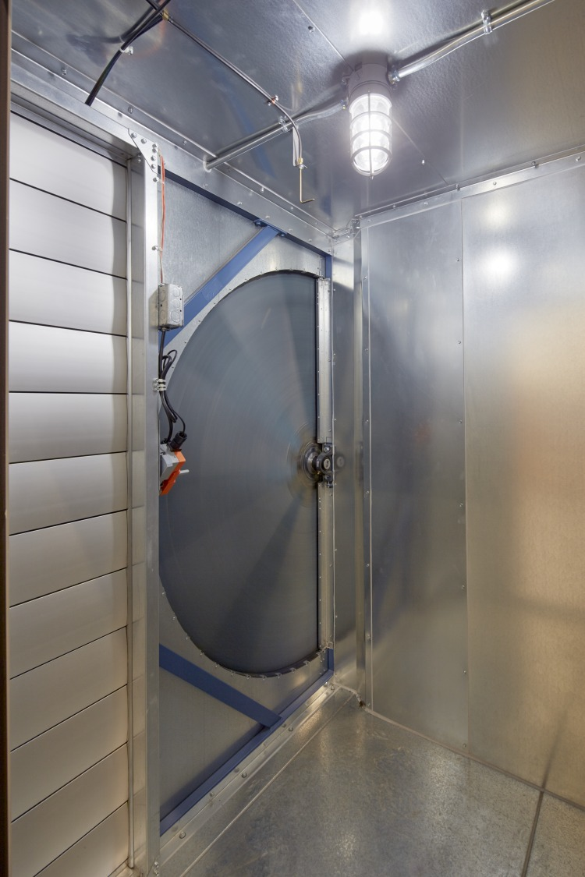
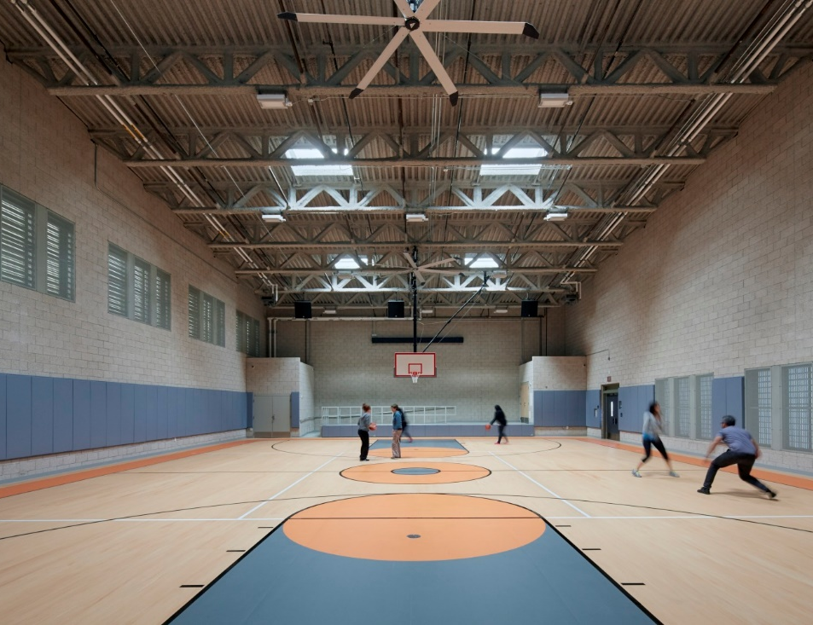
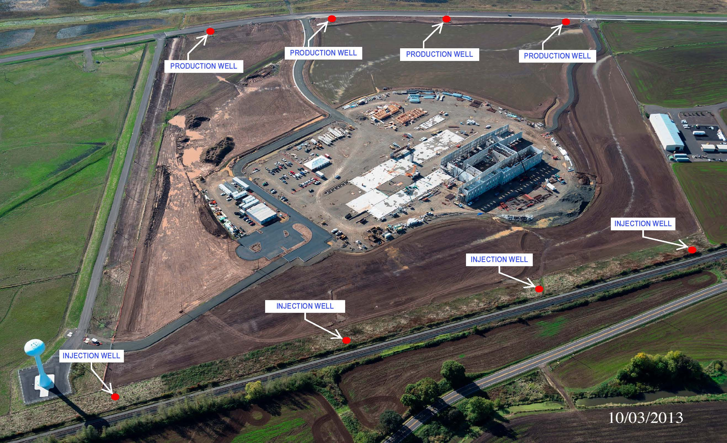
ASHRAE 209: Select (at least) One Cycle:
Section 6.6 “Modeling Cycle 6 - Design Integration and Optimization”
Oregon State Hospital in Junction City: tight envelope with limited WWR optimized daylighting while reducing heating & cooling loads. Night flushing was employed in select spaces (e.g. gymnasium). Chilled beams reduced F2F height. Energy recovery & demand-controlled ventilation reduced loads. Geoexchange, solar thermal H2O support 100% heating & cooling needs.
Notes:
ENCOURAGED: This cycle is strongly recommended as a Basic Service.
As the building design becomes more detailed, as enclosure materials and glazing systems are selected, systems and sub-systems more detailed and complex, HVAC system components, sensors and controls, scheduling, etc. are determined, the model can get more detailed and more accurate. If a couple of options are under consideration, the model can be used to evaluate merits (energy savings) of those options. the model can be updated and iterated for multi-variable optimization. This allows the team to identify when two or more design elements have a compounding impact on energy performance. This cycle should be iterative, and the number of iterations depends on the size and complexity of the project as well as the design schedule. After each iteration, a model review meeting or discussion would be helpful to discuss EEM and design opportunities. These meetings should be coordinated with commissioning activities.
NB: There may be variations in the energy standards cited for code and certifications like LEED, so while the ‘design case’ may consistently reference the same standard, there may be one or more variations to the baseline model.
WHEN: This cycle should be iterative and may include check-ins at 50% and 100% Design Development, 50% and 95% Construction Documents, to be defined in the Architect-Consultant scope agreement.

Slide 39
ASHRAE 209: Visualized
May occur in DD & CDs, but even as early as SD; recommended defined number of iterations as basic service with additional add services in contract scope language
Concept Design
Schematic Design
Design Development
Construction Documents
Construction Administration
Post Occupancy
5.3 Climate & Site Analysis
5.4 Benchmarking
6.1 Simple box model
6.2 Conceptual design model
6.3 Load reduction model
6.4 HVAC system selection model
6.5 Design refinement models (50%, 100%)
6.5 Design refinement model (50%)
6.6 Design integration & optimization (100%)
6.7 Simulation aided value engineering
6.6 Design integration & optimization (50%, 95%)
6.7 Simulation aided value engineering
7.1 As-designed Energy Performance
ASHRAE 209 energy modeling
7.1 As-designed Energy Performance
7.2 Change Orders
7.3 As-built energy performance
8.1 Post-Occupancy energy performance comparison
5.6 Project targets & goals integrated with Owner’s Project Requirements (OPR)
Design Team: issue Basis of Design (BOD)
CxA: Coordination with model reviews
CxA: Cx Plan, OPR/BOD alignment; Peer review dwg sets, outline spec;
Coordination with model reviews
CxA: Peer review dwg sets, Cx spec, pre-functional checklists;
Coordination with model reviews
10-month site revisit
Monitoring Based Commissioning
*Occupant Comfort Survey
Commissioning activities
Onsite Cx activities;
Coordination with model reviews; O&M manuals, O&M training; Retro-Cx planning
Stakeholder workshops
5.5 Energy Charrette
50% & 100% model review workshops
Cx & model review workshops
Cx & model review workshops
Construction kick-off;
Cx activities and meetings; model review workshops
POE, Lessons Learned & model review workshop

Slide 40
ASHRAE 209: Select (at least) One Cycle:
Section 6.7 “Modeling Cycle 7 - Energy Simulation Aided Value Engineering”
This cycle is recommended as an Additional Service as needed to support VE discussions and to inform decisions.
Protects performance while managing budget.
Coordinate with Cx and BECx activities.
This cycle should be conducted as needed, typically in DD & CDs.
Simulation-aided VE in DD reduced WWR, improved glazing, peak cooling loads, eliminated a chiller and brought mechanical budget back in line while reducing EUI and saving net $500k.
Notes:
IF APPLICABLE: This cycle is recommended as an Additional Service if needed to support Value Engineering discussions and to inform decisions.
This cycle of simulation can support VE decisions, for example, 1. a reduction in window to wall ratio or improvement to higher performance glazing (or combination of both strategies) that reduces peak cooling loads sufficiently to eliminate a chiller while also maintaining performance expectations 2. a reduction in perimeter glazing or improvement in glazing characteristics to eliminate the perimeter heat system while maintaining performance and occupant comfort. Both exercises a) bring the project back into budget, b) validate performance targets will be maintained even with design changes. Energy simulation in this cycle is intended to confirm that performance expectations are maintained despite taking the VE option, or else the option may be discarded.
After each VE model is run, a model review meeting or discussion would be helpful to discuss outcomes and opportunities, as well as to make decisions and give direction for design changes. These meetings should be coordinated with commissioning activities.
NB: There may be variations in the energy standards cited for code and certifications like LEED, so while the ‘design case’ may consistently reference the same standard, there may be one or more variations to the baseline model.
WHEN: This cycle should be conducted as needed, typically in Design Development and Construction Documents VE exercises. Inclusion as a Basic Service or Additional Service to be defined in the Architect-Consultant scope agreement.

Slide 41
ASHRAE 209: Visualized
Include as Basic Service if needed for Code Compliance or LEED Documentation
Concept Design
Schematic Design
Design Development
Construction Documents
Construction Administration
Post Occupancy
5.3 Climate & Site Analysis
5.4 Benchmarking
6.1 Simple box model
6.2 Conceptual design model
6.3 Load reduction model
6.4 HVAC system selection model
6.5 Design refinement models (50%, 100%)
6.5 Design refinement model (50%)
6.6 Design integration & optimization (100%)
6.7 Simulation aided value engineering
6.6 Design integration & optimization (50%, 95%)
6.7 Simulation aided value engineering
7.1 As-designed Energy Performance
ASHRAE 209 energy modeling
7.1 As-designed Energy Performance
7.2 Change Orders
7.3 As-built energy performance
8.1 Post-Occupancy energy performance comparison
5.6 Project targets & goals integrated with Owner’s Project Requirements (OPR)
Design Team: issue Basis of Design (BOD)
CxA: Coordination with model reviews
CxA: Cx Plan, OPR/BOD alignment; Peer review dwg sets, outline spec;
Coordination with model reviews
CxA: Peer review dwg sets, Cx spec, pre-functional checklists;
Coordination with model reviews
10-month site revisit
Monitoring Based Commissioning
*Occupant Comfort Survey
Commissioning activities
Onsite Cx activities;
Coordination with model reviews; O&M manuals, O&M training; Retro-Cx planning
Stakeholder workshops
5.5 Energy Charrette
50% & 100% model review workshops
Cx & model review workshops
Cx & model review workshops
Construction kick-off;
Cx activities and meetings; model review workshops
POE, Lessons Learned & model review workshop

Slide 42
ASHRAE 209: Optional Cycles
Section 7.1 “Modeling Cycle 8 – As-Designed Energy Performance”
This cycle is strongly recommended as a Basic Service.
This cycle of modeling is typically necessary to demonstrate code compliance under the performance path.
This cycle is also used for LEED documentation.
This model is not intended to provide design feedback, assist with VE exercises or improve the project in any way. It is a close-out of design.
This cycle is conducted at the end of CDs (100%) for permit application, and often overlaps with the beginning of CA for LEED documentation.
Notes:
ENCOURAGED/REQUIRED: This cycle of modeling is typically necessary to demonstrate code compliance. This cycle is strongly recommended as a Basic Service.
This cycle is often referred to as a ‘compliance model’ or ‘documentation model’ as it is a model reflective of the completed design, intended to demonstrate compliance with the energy code and/or LEED criteria (or other certification program). There may be variations in the energy standards cited for code and certifications like LEED, so while the ‘design case’ may consistently reference the same standard, there may be one or more variations to the baseline model.
This model is not intended to provide design feedback, assist with VE exercises or improve the project in any way. It is a close-out of design modeling in order to obtain a permit or LEED points. Unfortunately, for too many projects this is the first and only fully executed energy model contracted in the design process. This is too late to improve the design or identify savings in construction costs or annual operating expenses. 99.9% of the value in energy modeling has been left on the table.
WHEN: This cycle is conducted at the end of Construction Documents for permit application, and often overlaps with the beginning of Construction Administration for LEED documentation.

Slide 43
Managing Performance: Energy Modeling Tools
Notes:
Real change in any endeavor is not achievable unless you set targets, measure performance, and track progress toward your goal.
Whether energy performance, diversity or even something as simple as weight loss.
You are what your measure. This is the intent behind BPS.
Given all that is at stake in reducing energy use and carbon footprints, it is important to know how to comply with these requirements in a way that does not create additional liability for the architect.

Slide 44
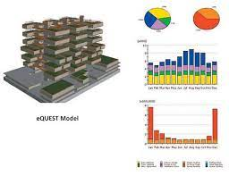
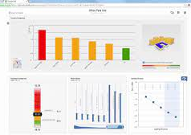
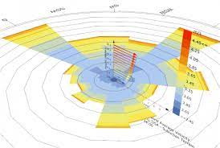
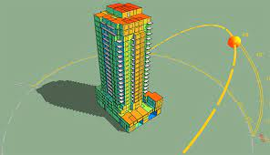
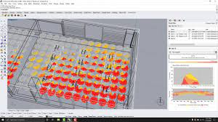
Ex. Modeling Tools by Phase
Concept Design
Schematic Design
Design Development
Construction Documents
Construction Administration
Post Occupancy
Concept modeling, Google SketchUp+EnergyPlus (free)
Whole building energy simulation. eQuest is a graphic user interface for DOE-2 engine, runs faster. EnergyPlus has modeling capabilities beyond DOE-2, better for more complex bldgs, may be more accurate, but runs slower. EnergyPlus manual input (free). DesignBuilder CAD interface (license).
Building simulation coupled with preliminary systems strategies, BIM (license)
Free tool for benchmarking one or more buildings on single or multiple sites; includes energy, GHG, water, etc. Integrates with DC benchmarking regs. & BEPS
Concept modeling, Rhino (free)
Rapid simulation of design complexities at building or campus scale, Rhino (license)
Whole building energy simulation, directly imports BIM model, good with complex geometries (license)

Slide 45
 | EnergyPlus: better for more complex bldgs., design ideas | eQuest: faster, better for simpler bldgs
HVAC Loads | More accurate; better with passive design strategies | Most errors when using thermal mass
Integrated loads & systems | Bldg response to thermal loads calculated simultaneously with system operation; better with passive design strategies | Bldg response to thermal loads calculated independently from system operation
Radiant exchange | Yes: explicitly models exchange between surfaces | Models through combined radiation/convection coefficients
Thermal Comfort | Yes: an develop surfaces temps, re: radiant comfort | Cannot model zone thermal comfort
HVAC Systems | Yes: systems built out of components w/ specific characteristics | Systems are pre-designed types, certain systems are not in model, cannot model enhancements, only one system per zone
Displacement Ventilation, UFAD | Yes: radiation and stratification; can model UFAD | Assumes all zones are fully mixed (not appropriate for displacement); cannot model UFAD or supply plenum
Radiant Heating & Cooling | Yes | No
Natural Ventilation | Yes: incl. wind, buoyancy, bldg’s thermal response | Can model simplified via operable windows and single zone system
Hydronic Loops | Heating and cooling can be modeled in separated distribution loops | Limited configurations
Moisture migration | Yes | No
Multiple time steps | Yes: sub-hourly | No. Only hourly
Emissions | Yes: emissions associated with energy use | No
Water usage | Yes | No
Renewable Energy | Yes: standalone or BIPV | PV
Co-gen | Yes: cogeneration with IC engine, micro-CHP, fuel cells. | Somewhat: cannot model IC engine or fuel cells
Daylighting & Controls | Yes: detailed modeling of daylight & control scenarios | Somewhat: overestimates benefits
Windows & Shading Controls | More shading & controls for windows & skylights | limited
Demand response | Yes: limiting controls for lighting, equipment, zone thermostat. | No
Outdoor Lighting & Controls | Yes | No
Green Roof | Yes | No
Visual Comfort | Yes | No
Notes:
https://core.ac.uk/download/pdf/79559397.pdf

Slide 46
Managing Performance: Consultant Contract Language
Notes:
Focus on Energy Modeling Subconsultant Agreement in the context of AIA Standard Form Agreements.
Drill down on specifics of how Energy Modeling may work across the standard design phases.
CAVEATS:
We will discuss a process for compliance with BPS in the context of standard form industry contracts; specifically, the C401 – Standard Form Agreement Between Architect & Consultant
A few things about the contract language:
The language proposed is neutral enough to apply across jurisdictions; we will point out how the language should be interpreted under the CEDC Act
While we are using AIA Documents and I serve on the AIA Documents Committee, the modifications are not AIA approved alternative language. There is no express or implied endorsement of this language by the AIA or the AIA Documents Committee
We will discuss a conceptual approach to addressing BPS. Every project is different. HOK is not providing legal advice by offering these modifications. Always consult with your own legal counsel on appropriate contract language.

Slide 47
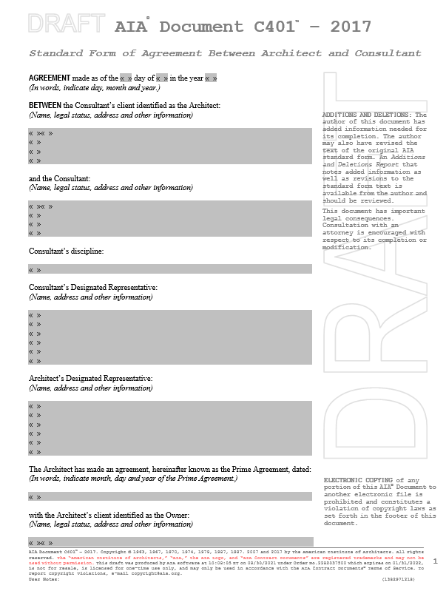
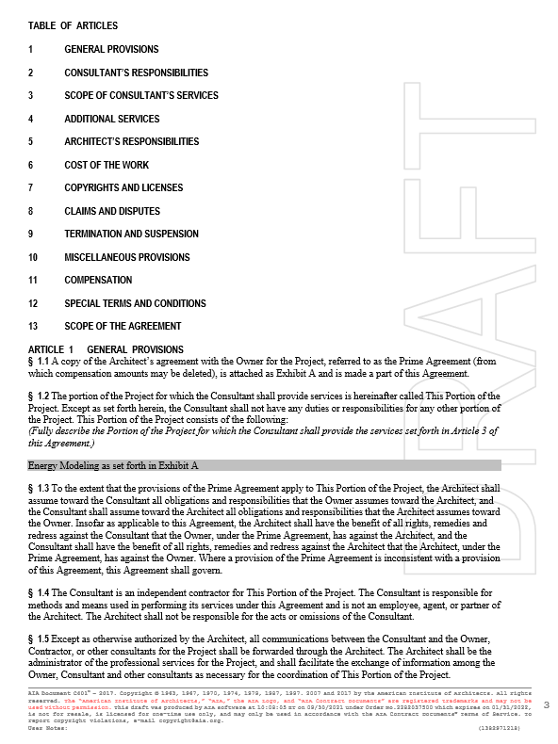
Notes:
This “Portion of the Project” is the Energy Modeling as set forth in Exhibit A

Slide 48
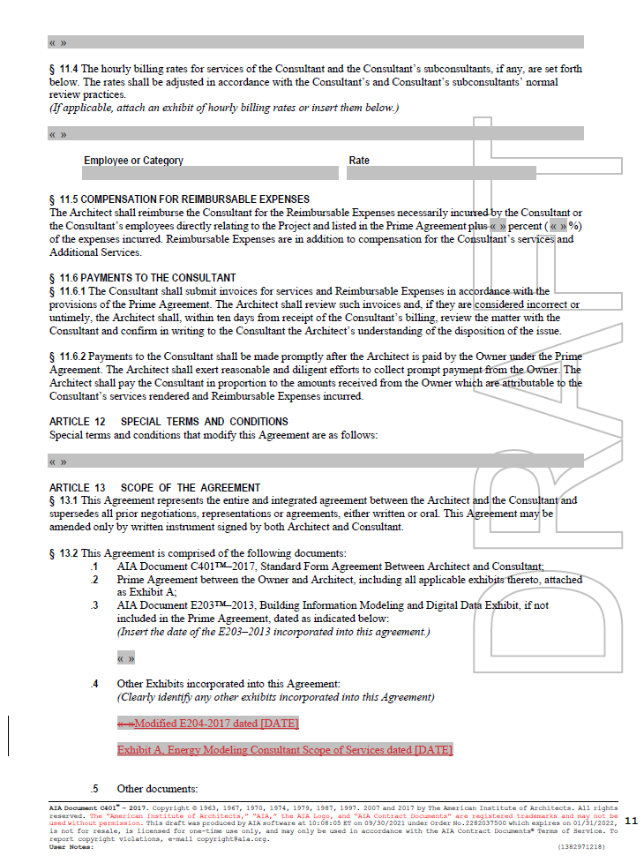
Notes:
Incorporate by reference:
Modified E204 discussed in Module 1
Energy Modeling Scope of Services described in Exhibit A

Slide 49
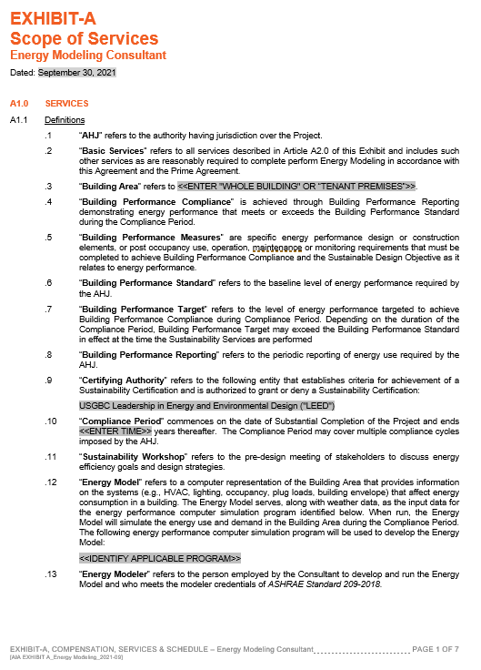
Notes:
COMPLIANCE PERIOD IS KEY
Compliance Period is the agreed window during which Building Performance Compliance will be achieved.
Unless you’re designing to net-zero or net-positive energy performance, there must be a horizon on HOK’s design window
This is a contractual (finite) time period. It does not represent the Owner actual compliance obligation (indefinite).
It is the minimum period the project will be designed to achieve compliance with the BPS without improvements.
It can extend from 1 to as many compliance cycles as the Owner’s program, budget and schedule will permit.
Documenting the Compliance Period is one of the most important aspects of this effort. It allows stakeholders to:
Evaluate BPS and impacts on program, budget, & schedule
Assist Owner in making an informed decisions on its capital investment
Document this decision in some way
BUILDING PERFORMANCE STANDARD
CEDC Act – the median local ENERGY STAR score by peer building group
AHJ is the Department of Energy and Environment
BUILDING PERFORMANCE TARGET
The median local ENERGY STAR score for the building peer group at the end of the compliance period
Factors to consider in setting the target
Duration of Compliance Period
General trend in the median ENERGY STAR score of the Project’s building peer group
Minimum level of energy performance improvement mandated by the DOEE (Compliance Pathway or otherwise)
Relying on prescriptive Energy Code or LEED requirements may not be enough
BPS are not static, they drive energy performance toward net-zero or net-positive performance.

Slide 50
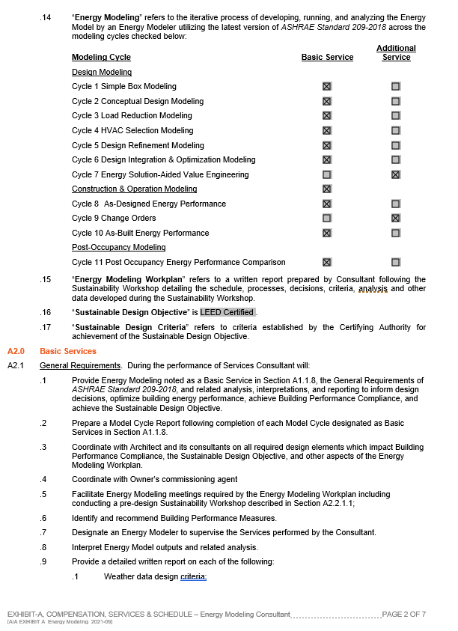
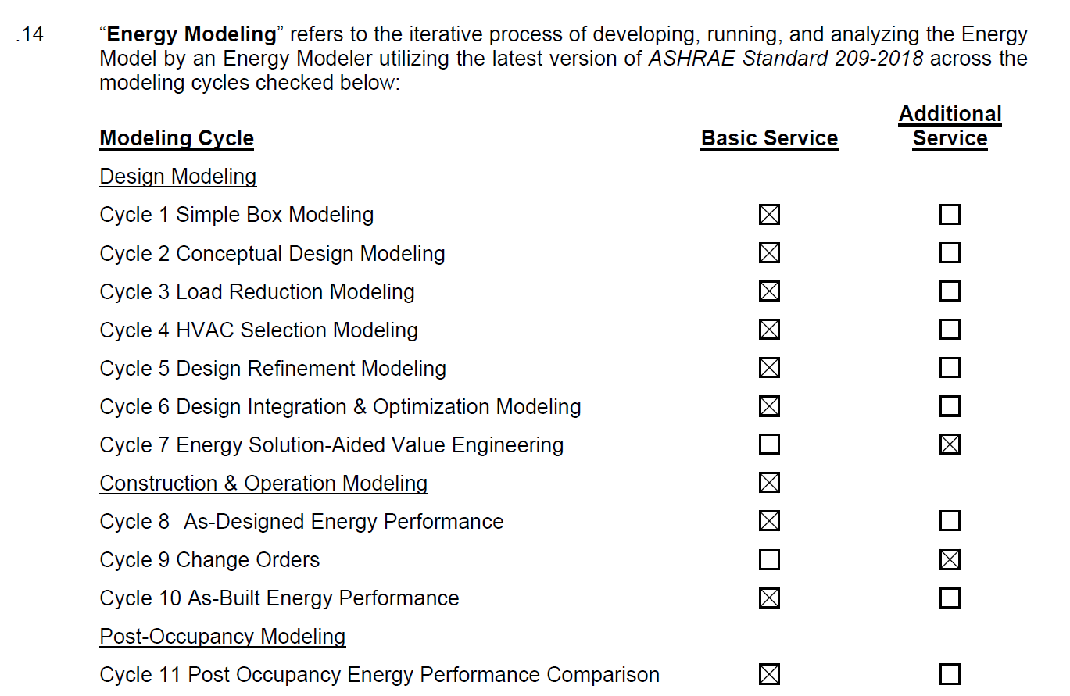
Notes:
ENERGY MODELING
Energy Modeling adds cost
ASHRAE 209 is a cafeteria approach – not all energy cycles required
Minimal requirement for ASHRAE 209 compliance
General Requirements (Section 5)
Model Cycle 3, Load Reduction
One additional design phase Model Cycle
Recommended: Model Cycle 3 + 1, 2, 4, 5, 6 or 7

Slide 51
Notes:
EXPANDED GENERAL REQUIREMENTS
Coordinate w/ architect, consultants, CxAgent
Facilitate energy modeling meetings

Slide 52
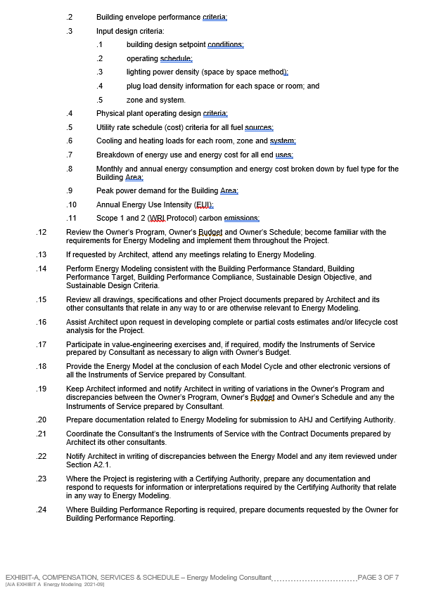
Notes:
Understand Owners program, budget, & schedule
Perform EM consistent with the Building Performance Standard
Keep the architect informed of variations to Owner’s program, budget or schedule that may impact energy performance

Slide 53
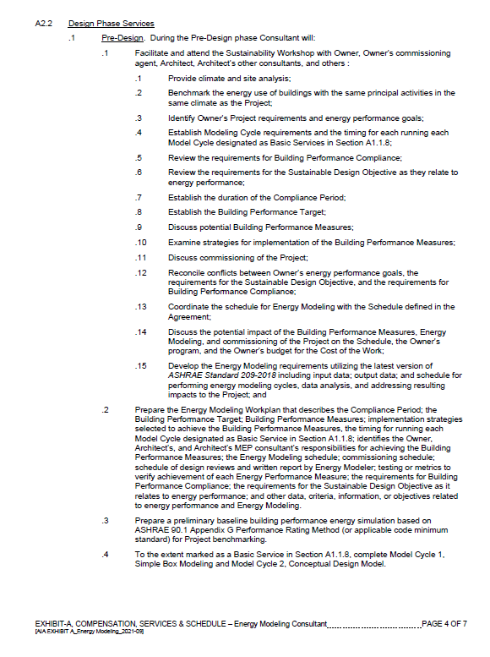
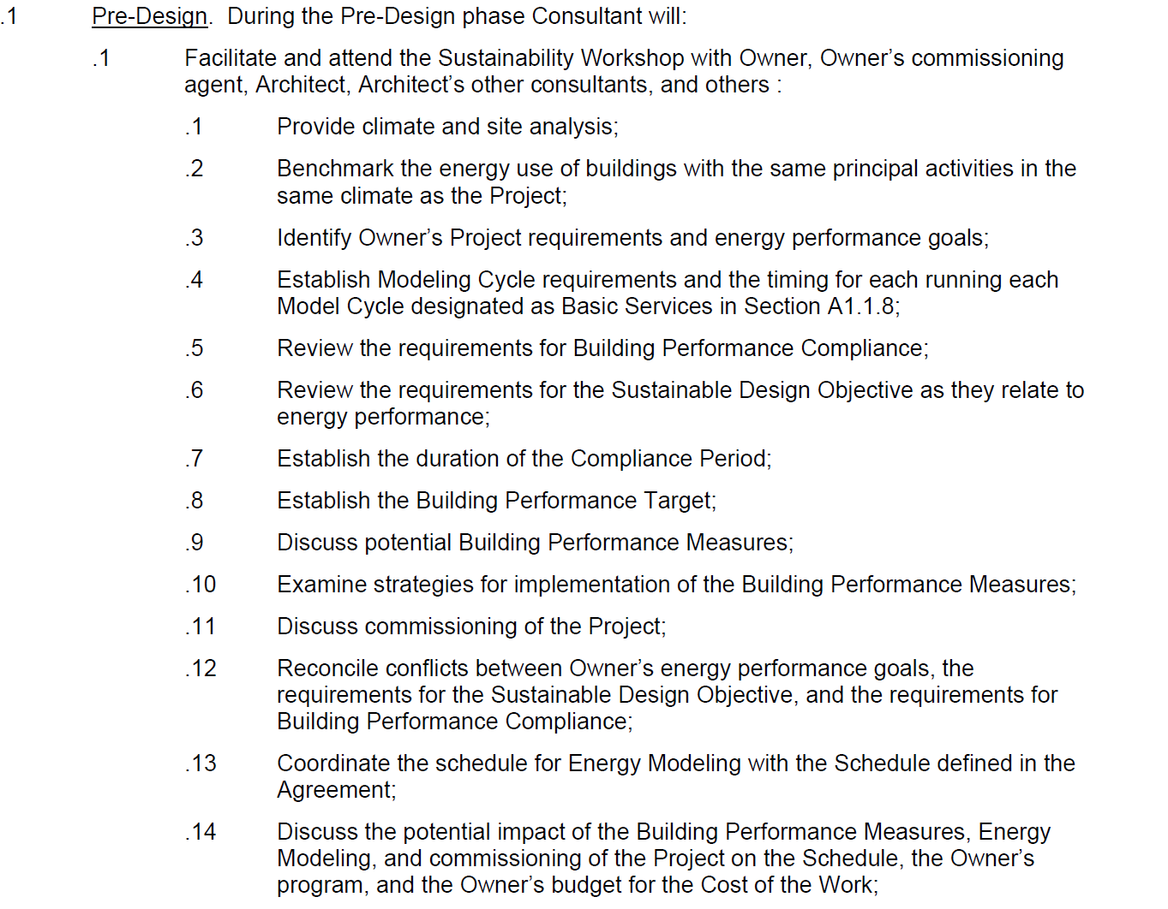
Notes:
SUSTAINABILITY WORKSHOP
It is important for all stakeholders participate in Energy Charette or Sustainability Workshop
It is important for the Energy Modeler to take a lead role during the Workshop discussing…

Slide 54
Notes:
ENERGY MODELING WORKPLAN
Describes the Compliance Period
Building Performance Targets
Building Performance Measures
Implementation strategies
Schedule for running Model Cycles
Schedule of Energy Modeling Reports
Testing/Metrics for achieving BP Compliance
Energy Modeling Workplan is incorporated into the Sustainability Plan

Slide 55
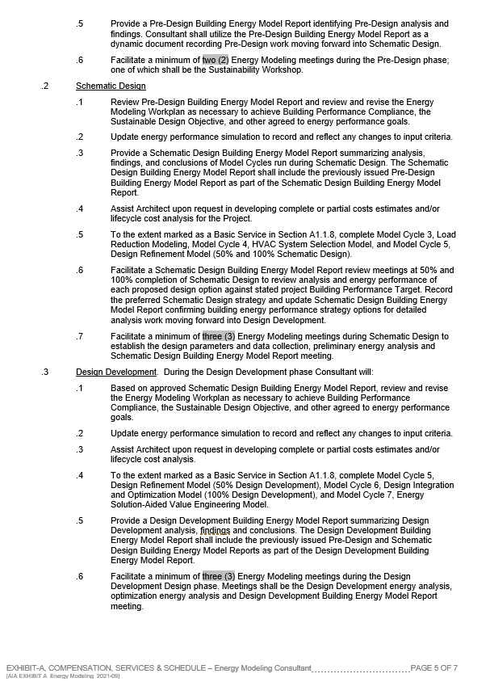
Notes:
AT EVERY PHASE…
Review Energy Modeling Report from prior phase
Adjust the Energy Modeling Workplan as necessary
Update model to record changes to input data
Run relevant Model Cycles
Facilitate Energy Modeling meetings at 50% & 100% completion to discuss:
Modeled performance against Building Performance Targets
Prepare Report conforming energy performance strategies

Slide 56
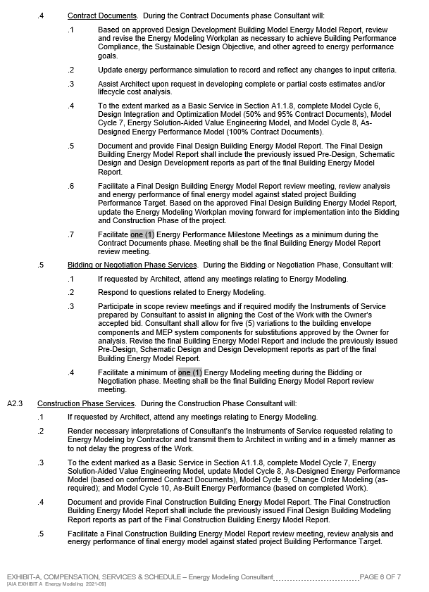

Slide 58
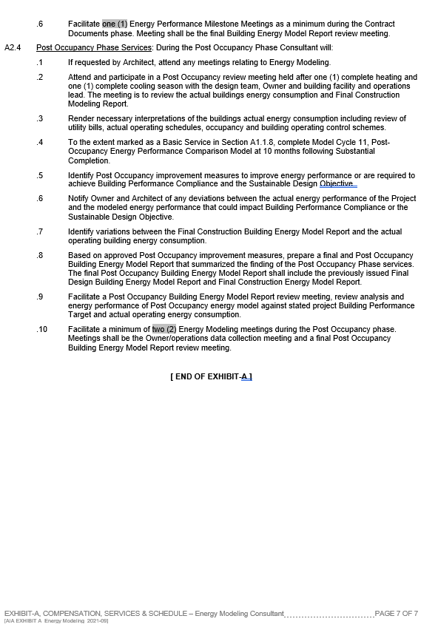

Slide 59
Managing Performance: Commissioning
Notes:
Real change in any endeavor is not achievable unless you set targets, measure performance, and track progress toward your goal.
Whether energy performance, diversity or even something as simple as weight loss.
You are what your measure. This is the intent behind BPS.
Given all that is at stake in reducing energy use and carbon footprints, it is important to know how to comply with these requirements in a way that does not create additional liability for the architect.

Slide 60
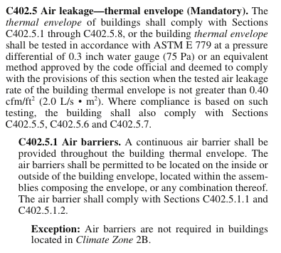
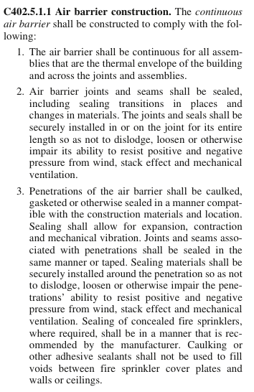
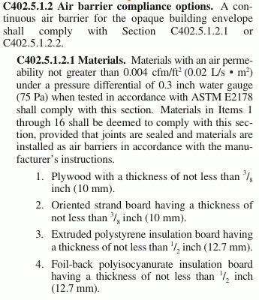
Air Leakage A402.5

Slide 61
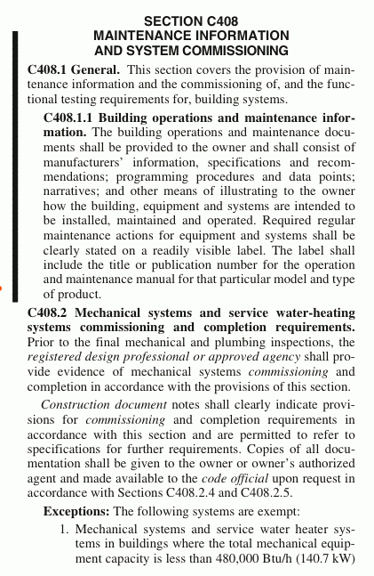
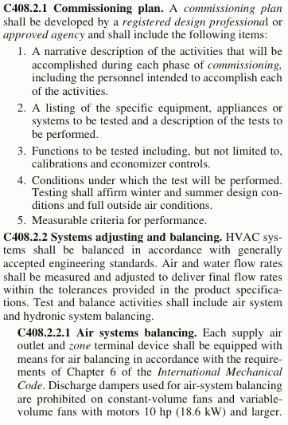
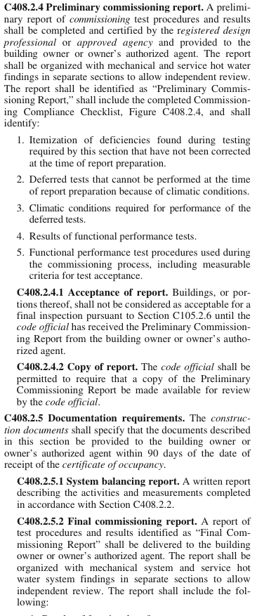
Systems Commissioning

Slide 62
Design vs. Performance
Notes:
Real change in any endeavor is not achievable unless you set targets, measure performance, and track progress toward your goal.
Whether energy performance, diversity or even something as simple as weight loss.
You are what your measure. This is the intent behind BPS.
Given all that is at stake in reducing energy use and carbon footprints, it is important to know how to comply with these requirements in a way that does not create additional liability for the architect.

Slide 63
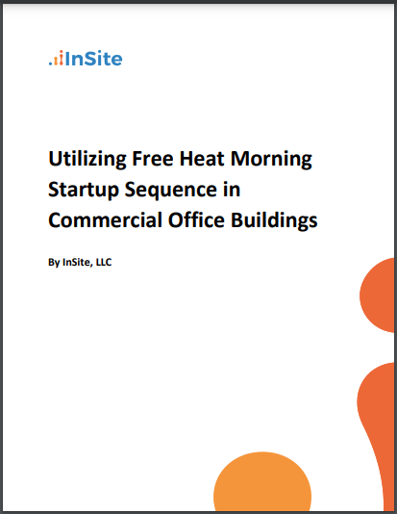
700 6th Street NW
Washington, DC
288,000 SF
LEED CS Platinum, EBOM Platinum
Design: 2005
Complete 2009
pEUI 2008: 42 kBtu/sf/yr
…
EUI 2012: 48.6 kBtu/sf/yr Energy Star: 79
EUI 2013: 60.4 kBtu/sf/yr Energy Star: 81
EUI 2014: 60.9 kBtu/sf/yr Energy Star: 81
EUI 2015: 69.5 kBtu/sf/yr Energy Star: 77
EUI 2016: 62.4 kBtu/sf/yr Energy Star: 68
EUI 2017: 62.0 kBtu/sf/yr Energy Star: 69
EUI 2018: 66.2 kBtu/sf/yr Energy Star: 73
EUI 2019: 52.0 kBtu/sf/yr Energy Star: 84
EUI 2020: 34.1 kBtu/sf/yr Energy Star: 92
EUI 2021: 34.2 kBtu/sf/yr Energy Star: 91
Benchmarking begins
CEDC is passed, including BEPS

Slide 64
What influences performance vs. model?
Issue | Example | Design/Construction | Post-Occupancy
Occupant Behavior | Occupants aren’t in their offices at the times it was assumed they would be. Lights, HVAC run all day, then occupants come in after hours and turn on lights, HVAC, etc. | Lights, HVAC controlled by actual occupancy rather than scheduling. Recommend to Owner that they submeter tenant spaces (specifically for plug loads or other behavior-related energy end uses) | Recommend to Owner that they submeter tenant space, include language in tenant lease language that supports responsible energy management.
Tenant fitout/ Significant Plug Loads | Tenant installs significant plugloads, e.g. a ‘data center’ or large computer rooms; Tenant installs food service equipment | Submeter tenant spaces + all spaces that vary in use type and energy consumption! | Recommend that Owner update Energy Star Portfolio Manager entry to reflect separate energy uses/space types per submeters.
Operations and Maintenance | Infrequent or no filter changes, Overrides to programming, setpoints, controls | Pursue LEED ‘Enhanced Commissioning’ credit which includes O&M components and a site re-visit in 10 months; Recommend an O&M plan and training for O&M personnel at project turnover | Recommend to Owner training for O&M personnel every 18-24 months; Recommend filter logs; maintenance logs Recommend retro-commissioning every 5 years
Construction Quality | Building envelope or duct air leakage | Choose an experienced BECxA, ensure all required steps in Cx process occur in timely manner to give useful feedback in design and construction | Recommend owner pursue Enhanced Cx & follow up with 10-month site revisit (during warranty period); Recommend Occupant Comfort Survey (during warranty period)
Change in use/occupancy from anticipated use or occupancy | Owner turns intended yoga studio into supermarket; Shell space in academic building intended for classroom is fitout with lab equipment during construction. | Update energy model during all phases of design and construction to reflect changes in the design. | Recommend to Owner that any changes in use or occupancy be accompanied by updates to building HVAC, lighting systems and energy model (and updated Target Finder score)

Slide 65
Incentives
Notes:
Real change in any endeavor is not achievable unless you set targets, measure performance, and track progress toward your goal.
Whether energy performance, diversity or even something as simple as weight loss.
You are what your measure. This is the intent behind BPS.
Given all that is at stake in reducing energy use and carbon footprints, it is important to know how to comply with these requirements in a way that does not create additional liability for the architect.

Slide 66
Inflation Reduction Act
Sec. 45L Homebuilder Tax Credit As noted under previous Residential slide, large multifamily residential buildings will be eligible, with credits of $2,500 per unit for meeting ENERGY STAR or $5,000 per unit for meeting DOE zero-energy ready.
Under the old structure, the credit has been limited to buildings three stories or less. No limit under this structure.
For affordable housing, new credits do not reduce LIHTC basis, allowing developers to take both 45L and LIHTC.
Updates take effect 1/1/2023 for 10-year extension through 12/31/2032

Slide 67
Inflation Reduction Act
Sec. 179D Tax Deduction for Energy Efficient Commercial Buildings Significantly expanded incentive starting Jan. 1, 2023, from $1.80 per square foot currently to sliding scale of $2.50 -$5.00 per square foot, with new pathway for existing building retrofits to access the deduction.
New construction must achieve 25%-50% > evolving ASHRAE 90.1 reference standard;
Retrofits must demonstrate 25%-50% improvement over existing building performance (EUI).
Made permanent, adjusted for inflation annually.
Receiving full credit requires meeting prevailing wage and apprenticeship requirements.
Opens new eligibility for REITs to access the deduction.
Maintains provision allowing allocation of the deduction for public projects to project designer (for schools, municipal , etc.), and expands allocation option to be used by tribal government projects and projects by nonprofits.
Updates take effect 1/1/2023

Slide 68
Inflation Reduction Act
Sec. 30C EV Infrastructure Tax Credit Expands and extends through 2032 the tax credit for “qualified alternative fuel vehicle refueling property,” including EV charging systems.
Credit of 30% of expenses up to $100,000 per charging/fueling unit on commercial properties, including retail, office, etc. (Past cap was $30,000 per property.)
Must meet prevailing wage and apprenticeship program requirements or credit is reduced to 6%.
Eligible properties must be in targeted rural or low-income census tracts starting in 2023.
Bidirectional charging equipment eligible starting in 2023.

Slide 69
Inflation Reduction Act
Sec. 48 Clean Electricity Tax Credit Expands and extends the Investment Tax Credit (ITC) for clean energy property investments, including solar, geothermal and combined heat and power.
For most projects, credit of up to 30% of costs if prevailing wage and apprenticeship requirements are met, dropped to 6% if requirements are not met.
Credit increased by an additional 10% if domestic content requirements are met and another 10% if project is located in a designated “energy community” such as a brownfield site or a census tract with shuttered coal operations.
Eligibility is expanded to cover new technologies including energy storage technology, microgrid controllers and dynamic glass.
Starting in 2025, for most technologies, ITC converts to a tech-neutral structure with similar incentives based on GHG reduction.

Slide 70
Resources for incentives
https://incentifind.com/
https://www.dsireusa.org/
https://www.usgbc.org/resources/inflation-reduction-act-buildings-provisions
https://content.aia.org/sites/default/files/2022-08/Memo_Inflation_Reduction_Act_FINAL_8_10_2022.pdf
AIA + USGBC Webinar: Zoom at this site. passcode is: 8^I?$8CS

Slide 71
E204 – A Process for Informed Decision-Making
Anica Landreneau, Assoc. AIA, LEED AP BD+C, WELL AP, fitwel
Sustainable Design Director | Senior Principal | HOK
Anica.landreneau@hok.com | +1 202.944.1490
Donovan Olliff, AIA
Senior Vice President | General Counsel | HOK
Donovan.Olliff@hok.com | 314.754.3961
Allison Johnson, AIA, LEED AP BD+C, WELL AP
Sustainable Design Leader | HOK
Allison.johnson@hok.com | 314.754.4036
Understand the Problem
Maximizing Energy Performance within program, budget & schedule constraints
Evaluate Alternatives
Net-zero/Net-positive or “something less”
Discuss consequences of “something less”
Decide on an Approach
Design to achieve compliance for 1-3 Compliance Cycles
Improvements required for 4-6 Compliance Cycles
Document Everything
Problems discussed, Alternatives discussed, Solutions discussed, Decisions made
Notes:
As professionals, we guide our clients in making informed decisions every day
Selecting materials
Choosing a site
Awarding a contract
Making a change
This touches virtually every aspect of what we do.
We want to be TRUSTED ADVISORS to our clients.
Doing this well builds trust and long-term relationships.
Owners and A/Es have an affirmative duty to comply with prescriptive codes.
Owners also have an affirmative duty to comply with BEPs, however degree to which compliance is achieved is far more discretionary.

